Slide 1
DATA MINING
DB / information retrieval / deductive db system
DW perspective DM
Machine Learning system, Statistical Data Analysis
By DM – interesting knowledge, regularities, high level information extracted from db and viewed or browed from different angels
Knowledge useful in decision making, process control, info mgt, query
processing - which is interdisciplinary developments
Notes:
<number>

Slide 2
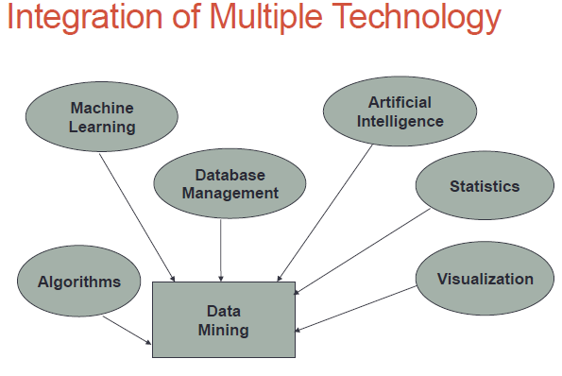
DM- /Promising interdisciplinary developments in the information Technology

Slide 3
Architecture Data Mining System
Graphical user interface
Pattern evaluation
Data mining engine
Knowledge-base
Database or data warehouse server
Data cleaning & data integration
Filtering/Selection
Data
Warehouse
Databases

Slide 4
DM – Architecture (Major Components)
Cont…,
Information repository
  Set of databases , spread sheets or any kind repositories
  Cleaning & Integration steps performed on data
DB/Data warehouse server
    Fetching the relevant data based on mining request
Knowledge base
  Domain knowledge to guide the search/ evaluate the interestingness of resulting patterns
  Knowledge can include concept hierarchies
  organize attribute values into different level of abstraction
Notes:
<number>

Slide 5
DM – Architecture (Major Components)
Data mining engine (consists functional modules for tasks
    Classification
    Characterization
    Association and correlation
    Prediction, outlier analysis, evolution analysis
Pattern evaluation module
  Pattern interestingness measurement
  Using thresholds to filter out the patterns
User Interface
  interface to user with the DM system with help of
  query, provides intermediate results to focus search
Notes:
<number>

Slide 6
Data Mining Architecture
Coupling

Slide 7
Coupling
Coupling –how DM system integrate with DB/ DW
DMS stand-alone/embedded in application - no integration with DB or DW - no coupling
However DM system works in an environment that requires to communicate with DB or DW requires some integration schemes

Slide 8
Data Mining Integration schemes
Possible integration schemes for the DM system to communicate with DB or DW is
  No coupling
  Loose coupling
  Semi tight coupling
  Tight coupling

Slide 9
No coupling
No coupling-
DM system will not utilize any function of a DB or DW. It fetch data from the file and store the mining results in another file
Simple but suffers from several drawbacks
No coupling represents poor design

Slide 10
Loose coupling
Loose coupling - DM system will use some facilities of a DB or DW system, fetching data from a data repository managed by these systems, perform data mining , stores the result in either a file or a place in DB or DW.
Better than no coupling because it use some of the features of DB or DW.
Difficult to achieve high scalability and performance with large data sets.

Slide 11
Semi Tight Coupling
Semi tight coupling – b
besides linking a DM system to a DB/DW system, efficient implementations of a few essential DM primitives can be provided in the DB/DW system
primitives -sorting, indexing, aggregation, multi-way join, and pre computation of some statistical measures, such as sum, count, max
frequently used intermediate mining results can be pre computed and stored in the DB/DW system.

Slide 12
Tight coupling
Tight coupling means that a DM system is smoothly integrated into the DB/DW system
Provide a uniform information processing environment
Highly desirable

Slide 13
DM- ON WHAT KIND OF DATA
Challenges and techniques of mining different for each repository system
RELATIONAL
TRANSCATIONAL
DATA WARHOUSE
ADVANCED DATA
Notes:
<number>

Slide 14
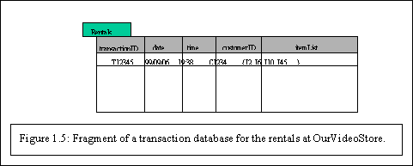
TRANSCATIONAL
Notes:
<number>

Slide 15
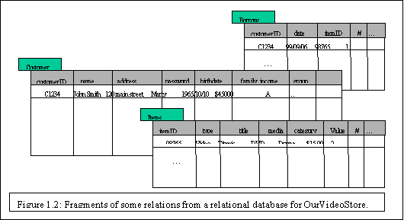
RELATIONAL
Notes:
<number>

Slide 16
DM- ON WHAT KIND OF DATA
RELATIONAL
To specify attributes to be included in the query and constraints on attributes , a given query transformed to set of relational operations , join, selection, projection
Query list of all items that were sold in the last quarter
With aggregation function avg, count, maximum, minimum. : total sales of the last month grouped by branch
How many sales transaction occurred in the month of December
Which sales person had the highest amount of sales.
By DM search trends or data patterns : anlayze customer data to predict the credit risk of new customers based on age, income, credit information
Notes:
<number>

Slide 17
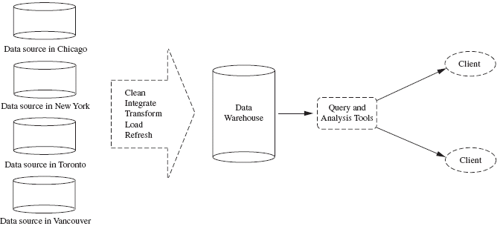
Data Warehouse
Data warehousing is defined as a process of centralized data management and retrieval.
Notes:
<number>

Slide 18
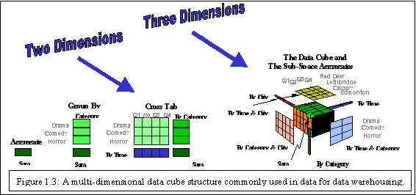
Data Warehouse
Notes:
<number>

Slide 19
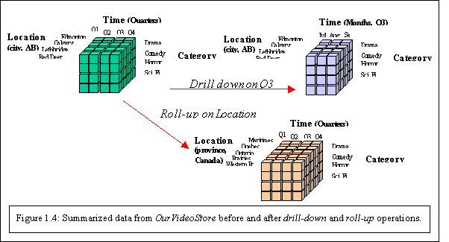
Data Warehouse
Notes:
<number>

Slide 20
DM- ON WHAT KIND OF DATA
Challenges and techniques of mining different for each repository system
RELATIONAL - SW manage and access the data and involve mechanisms for the definition of db structure, db storage, concurrent, shared or distributed data access and for ensuring the consistency and security of the information stored despite system crashes / attempt at unauthorized access.
RDb - TABEL, ATTRIBUTE (COL) , TUPLES (RECORD/ ROWS)-IDENTIFIED BY A SET OF ATTRIBUTES – ER MODEL
Notes:
<number>

Slide 21
Data Mining: Advanced Data? – with advancement of dbms
Advanced DB and information systems emerged to address the requirements of new applications.
  Object-oriented and object-relational databases
  Spatial databases
  Time-series data and temporal data
  Text databases and multimedia databases
  Heterogeneous and legacy databases
  WWW
Lecture-3 Data Mining: On What kind of data?

Slide 22
Data Mining: Advanced Data?
  Object-oriented and object-relational databases
  complex objects and structures, object relational db for most sophisticated DB concept of Object DB
  Entity – object eg. Employee, customer, items
  Encapusulation
  Messages
  Methods
  Inheritence
Lecture-3 Data Mining: On What kind of data?

Slide 23
Data Mining: Advanced Data?
  Time-series DB - stores sequences of values or events over repeated measurements of time ( hr, day, week) eg. Temp
  Temporal db- stores relational data include time related attributes like timestamps having different semantics
  Sequence db- stores sequences of ordered events with/
  without concrete notion of time Eg. Customer shopping sequences , biological sequence
Lecture-3 Data Mining: On What kind of data?

Slide 24
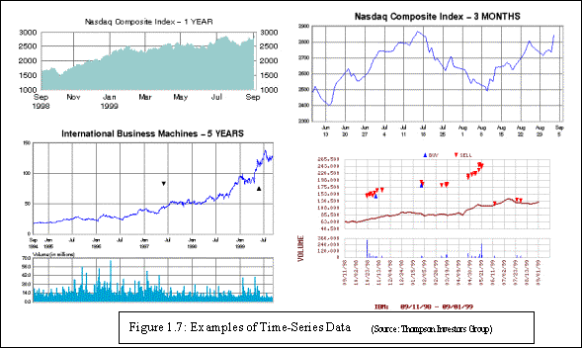
  Time-series data and temporal data
Notes:
<number>

Slide 25
Data Mining: Advanced Data?
  Spatial databases: Geographic map database (maps)
  VLSI, CAD, Medical, satellite image db.
  Eg. Characteristics house located near specific location
  Climate of mountainous area (Represented dimensional bit maps/ pixel)
  Text databases and Multimedia databases:
  Word description of objects with DM
  Construction, use of hierarchies : dictionaries, thesauruses
  Store image, audio, video data. Picture content based retrievel
Lecture-3 Data Mining: On What kind of data?

Slide 26
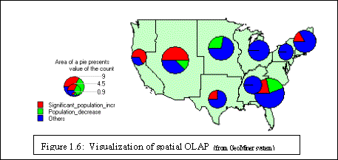
  Spatial databases
Notes:
<number>

Slide 27
WWW- provide rich worldwide online information service
Authoritative web page analysis rank the web pages based on their linkages and importance , influence, topics
Automated web page clustering and classification
Web usage mining/ web log mining -capturing user access patterns I such distributed information environments
User access pattern – efficient access between highly correlate objects improve system design marketing decisions: placing frequently visited documents

